Slide 1
Annual Day of Our College
EDGE-65

Slide 2
Welcome Speech
It is my pleasure to welcome you all to this special occasion. On behalf of [organisation/school/committee name], I extend a warm welcome to each one of you. We are honoured to have [mention the name of the chief guest or dignitaries] with us, whose presence adds great value to this event.
EDGE-65

Slide 3
Activity on Annual Day:
Music
Dance
Acting
EDGE-65

Slide 4
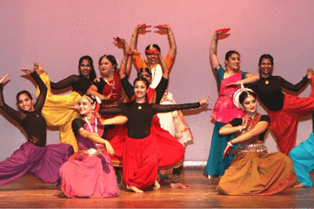
Picture of Annual Day of our College:
EDGE-65

